Slide 1
Announcements
Homework 4: MDPs (today’s topic)
Due Monday 9/26 at 11:59pm.
Project 2: Multi-Agent Pacman
Has been released, due Friday 9/30 at 5:00pm.
Contest 2, due at a time TBA, but soon after project 2.
Small tweak from contest 1.
Survey on how we’re doing so far has been released.
Due Saturday 9/24 at 11:59 PM.
+1 project point added to total (equivalent to one contest).
Midterm: Oct 6
Time to start studying.
Recommended approach:
Work through problems alone.
Get together in group of 3-6, and whiteboard attempted solutions.
Interrupt each other!
Fill out midterm conflict form ASAP. Makeup at 8 AM.

Slide 2
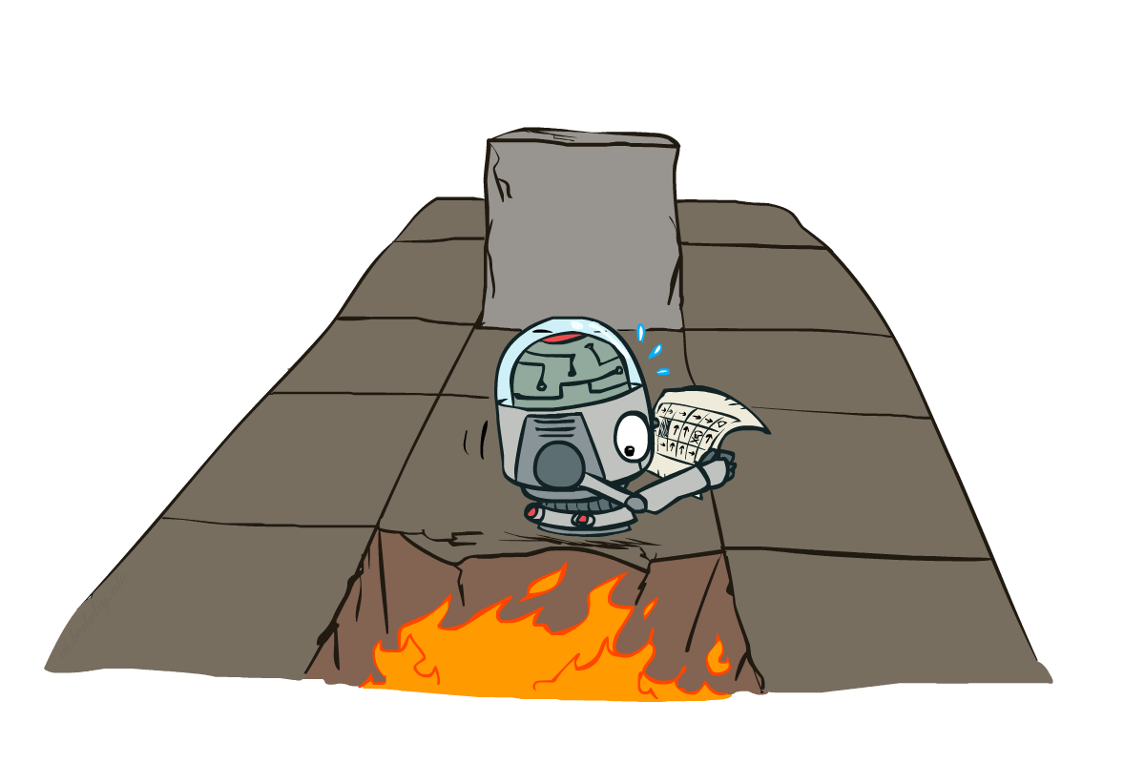
CS 188: Artificial Intelligence
Markov Decision Processes II
Instructors: Dan Klein and Pieter Abbeel --- University of California, Berkeley
[These slides were created by Dan Klein, Pieter Abbeel, Josh Hug for CS188 Intro to AI at UC Berkeley. All CS188 materials are available at http://ai.berkeley.edu.]
Notes:
Please retain proper attribution, including the reference to ai.berkeley.edu. Thanks!

Slide 3





Example: Grid World
A maze-like problem
The agent lives in a grid
Walls block the agent’s path
Noisy movement: actions do not always go as planned
80% chance: agent goes the way it wants to go (e.g. the action North takes the agent North)
10% chance: agent steps left (e.g. North, but goes West)
10% chance: agent steps right (e.g. North, but goes East)
If there is a wall in the direction the agent would have been taken, the agent stays put
0% chance to go backwards
The agent receives rewards each time step
Small “living” reward each step (can be negative)
Big rewards come at the end (good or bad)
Goal: maximize sum of rewards
Notes:
[cut demo of moving around in grid world program]

Slide 4
Recap: MDPs
Markov decision processes:
States S
Actions A
Transitions P(s’|s,a) (or T(s,a,s’))
Rewards R(s,a,s’) (and discount γ)
Start state s₀
Quantities:
Policy = map of states to actions
Utility = sum of discounted rewards
Values = expected future utility from a state (max node)
Q-Values = expected future utility from a q-state (chance node)
s
a
s, a
s,a,s’
s’

Slide 5
Optimal Quantities
The value (utility) of a state s:
V*(s) = expected utility starting in s and acting optimally
The value (utility) of a q-state (s,a):
Q*(s,a) = expected utility starting out having taken action a from state s and (thereafter) acting optimally
The optimal policy:
π*(s) = optimal action from state s
s
s is a state
a
(s, a) is a q-state
s, a
s,a,s’
(s,a,s’) is a transition
s’
[Demo: gridworld values (L9D1)]
Notes:
Demo just shows V and Q values, snapshots on next slides.

Slide 6
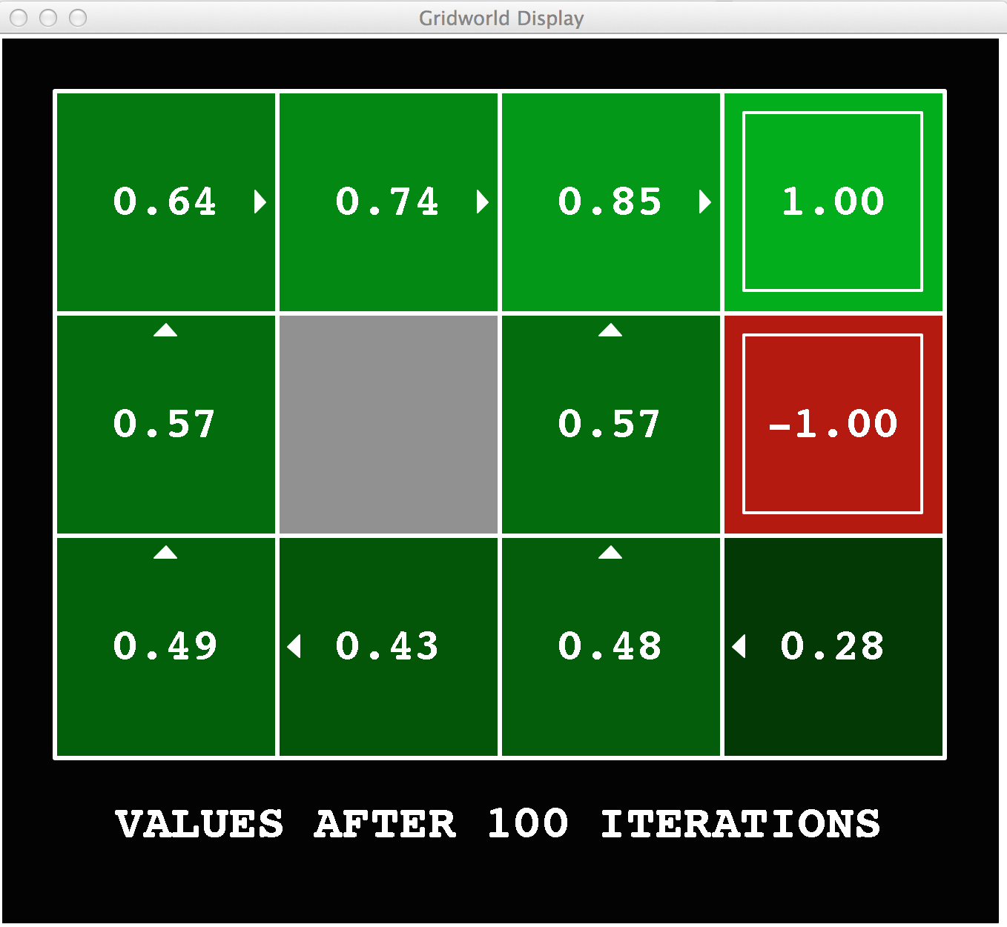
Gridworld Values V*

Slide 7
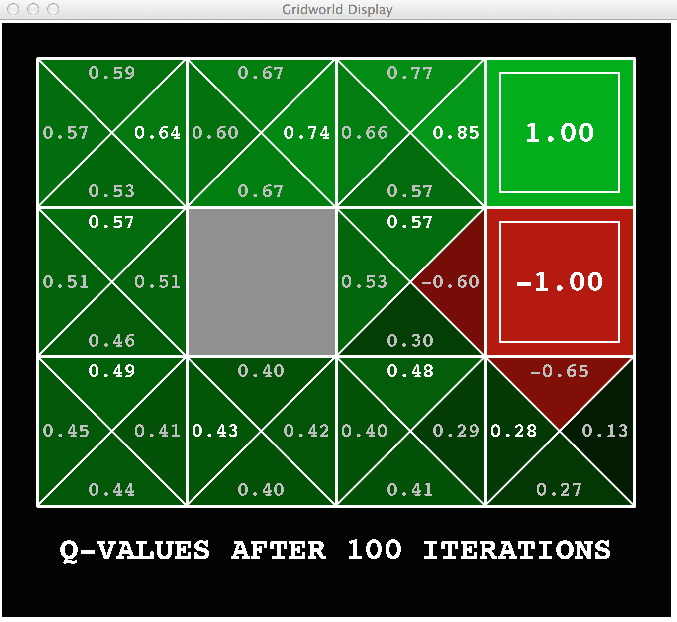
Gridworld: Q*

Slide 8

The Bellman Equations
How to be optimal:
Step 1: Take correct first action
Step 2: Keep being optimal

Slide 9

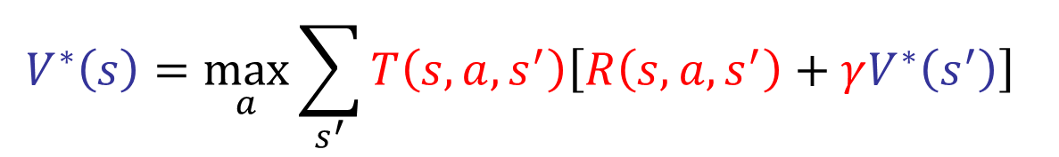
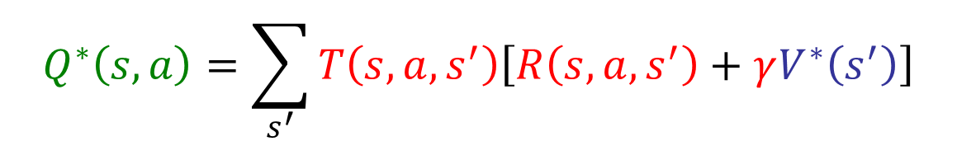
The Bellman Equations
Definition of “optimal utility” via expectimax recurrence gives a simple one-step lookahead relationship amongst optimal utility values
These are the Bellman equations, and they characterize optimal values in a way we’ll use over and over
s
a
s, a
$$V^{∗}\left(s\right)=\max_{a}{Q^{∗}\left(s, a\right)}$$
$$Q^{∗}\left(s, a\right)=\sum_{s^{′}}{T\left(s, a, s^{′}\right)\left[R\left(s, a, s^{′}\right)+γV^{∗}\left(s^{′}\right)\right]}$$
s,a,s’
s’
$$V^{∗}\left(s\right)=\max_{a}{\sum_{s^{′}}{T\left(s, a, s^{′}\right)\left[R\left(s, a, s^{′}\right)+γV^{∗}\left(s^{′}\right)\right]} }$$
Notes:
Let’s start by equations that characterize these quantities through mutual recursions. [step through this by writing on slide, one step at a time]
Recursive characterization of V* in terms of V*; not necessarily helpful; but it is a characterization.
Note: this is a set of equations that needs to be satisfied; but it could have multiple solutions (it does not, but at this stage of our knowledge it could).

Slide 10

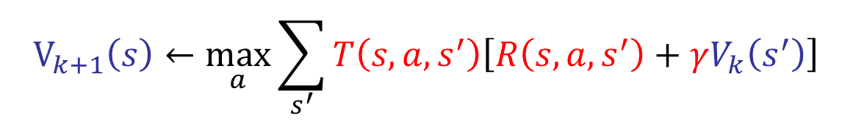
Value Iteration
Bellman equations characterize the optimal values:
Value iteration computes them:
Value iteration is just a fixed point solution method
… though the V_{k} vectors are also interpretable as time-limited values
V(s)
$$V^{∗}\left(s\right)=\max_{a}{\sum_{s^{′}}{T\left(s, a, s^{′}\right)\left[R\left(s, a, s^{′}\right)+γV^{∗}\left(s^{′}\right)\right]} }$$
a
s, a
s,a,s’
V(s’)
$$V_{k+1}\left(s\right)←\max_{a}{\sum_{s^{′}}{T\left(s, a, s^{′}\right)\left[R\left(s, a, s^{′}\right)+γV_{k}\left(s^{′}\right)\right]} }$$
Notes:
Discuss computational complexity: S * A * S times number of iterations
Note: updates not in place [if in place, it means something else and not even clear what it means]

Slide 11
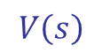
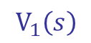
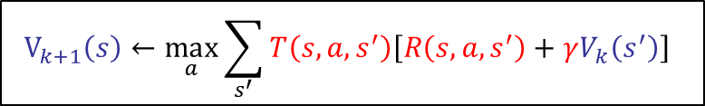
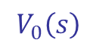
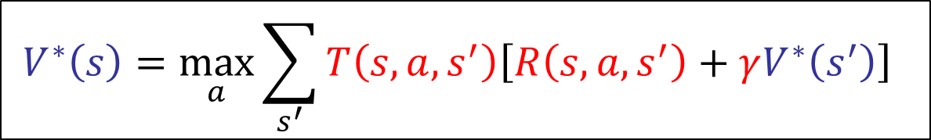
Value Iteration (Alternate View)
Bellman Equation gives us a way to characterize whether a vector of utilities is “correct”, i.e the vector is equal to the expected utilities if we play optimally.
$$V^{∗}\left(s\right)=\max_{a}{\sum_{s^{′}}{T\left(s, a, s^{′}\right)\left[R\left(s, a, s^{′}\right)+γV^{∗}\left(s^{′}\right)\right]} }$$
If we plug in our V(cool), V(warm), and V(OH),and the equation is satisfied, then our vector V is the expected utility if we play optimally.
2.375 1.375 0
$$V\left(s\right)$$
Can use value iteration to iteratively transform an initially all zero vector into the “correct’ vector. Or in other words, lets us compute the “correct” vector.
0 0 0
$$V_{k+1}\left(s\right)←\max_{a}{\sum_{s^{′}}{T\left(s, a, s^{′}\right)\left[R\left(s, a, s^{′}\right)+γV_{k}\left(s^{′}\right)\right]} }$$
2 1 0
…
$$V_{0}\left(s\right)$$
$$V_{1}\left(s\right)$$

Slide 12
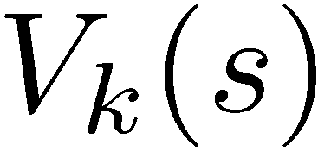
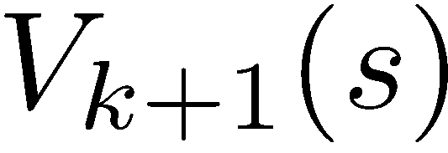
Convergence
How do we know the V_{k} vectors are going to converge?
Case 1: If the tree has maximum depth M, then V_{M} holds the actual untruncated values
Case 2: If the discount is less than 1
Sketch: For any state V_{k} and V_{k+1} can be viewed as depth k+1 expectimax results in nearly identical search trees
The difference is that on the bottom layer, V_{k+1} has actual rewards while V_{k} has zeros
That last layer is at best all R_{MAX}
It is at worst R_{MIN}
But everything is discounted by γ^{k} that far out
So V_{k} and V_{k+1} are at most γ^{k} max|R| different
So as k increases, the values converge

Slide 13
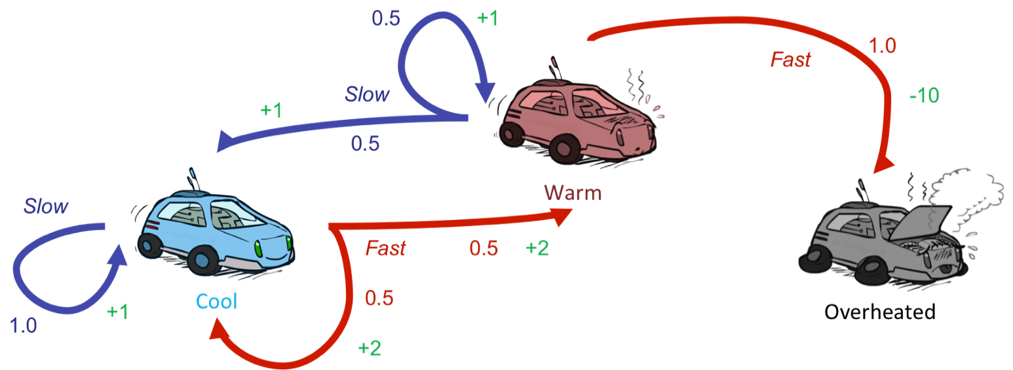


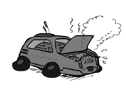
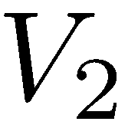
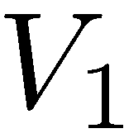
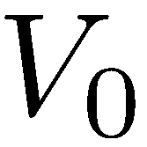
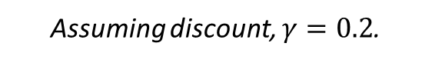

Issues with Value Iteration
2.3 (F) 1.3 (S) 0
2 (F) 1 (S) 0
$$V_{k+1}\left(s\right)←\max_{a}{\sum_{s^{′}}{T\left(s, a, s^{′}\right)\left[R\left(s, a, s^{′}\right)+γV_{k}\left(s^{′}\right)\right]} }$$
Issue #1: Slow, takes O(S²A) time.
Issue #2: Clearly terrible choices keep being tested.
e.g. no need to ever test the choice: (Warm, Fast).
Issue #3: Policy converges long before the values.
If using value iteration to find best policy, don’t actually care about values.
0 0 0
Assuming discount, $γ=0.2$.

Slide 14
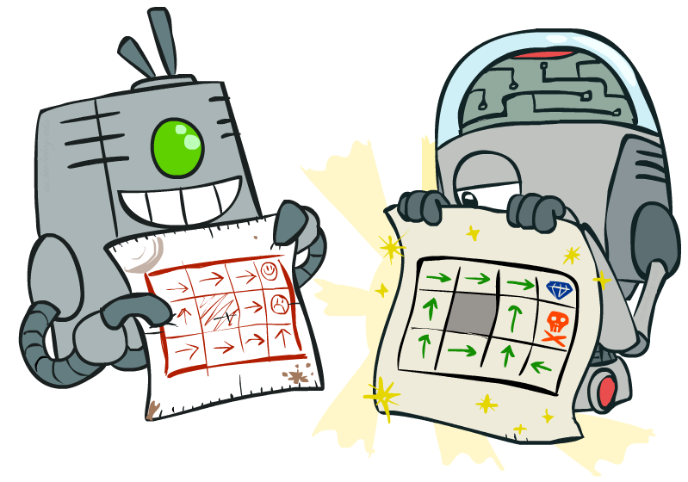
Policy Methods

Slide 15

Policy Evaluation

Slide 16
Fixed Policies
Do the optimal action
Do what π says to do
s
s
a
π(s)
s, a
s, π(s)
s,a,s’
s, π(s),s’
s’
s’
Expectimax trees max over all actions to compute the optimal values
If we fixed some policy π(s), then the tree would be simpler – only one action per state
… though the tree’s value would depend on which policy we fixed

Slide 17
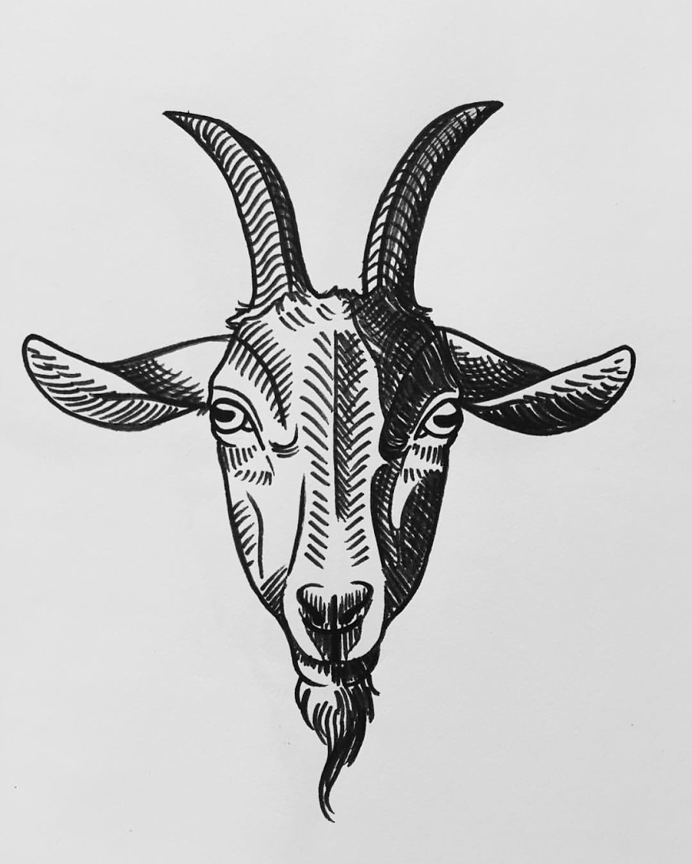
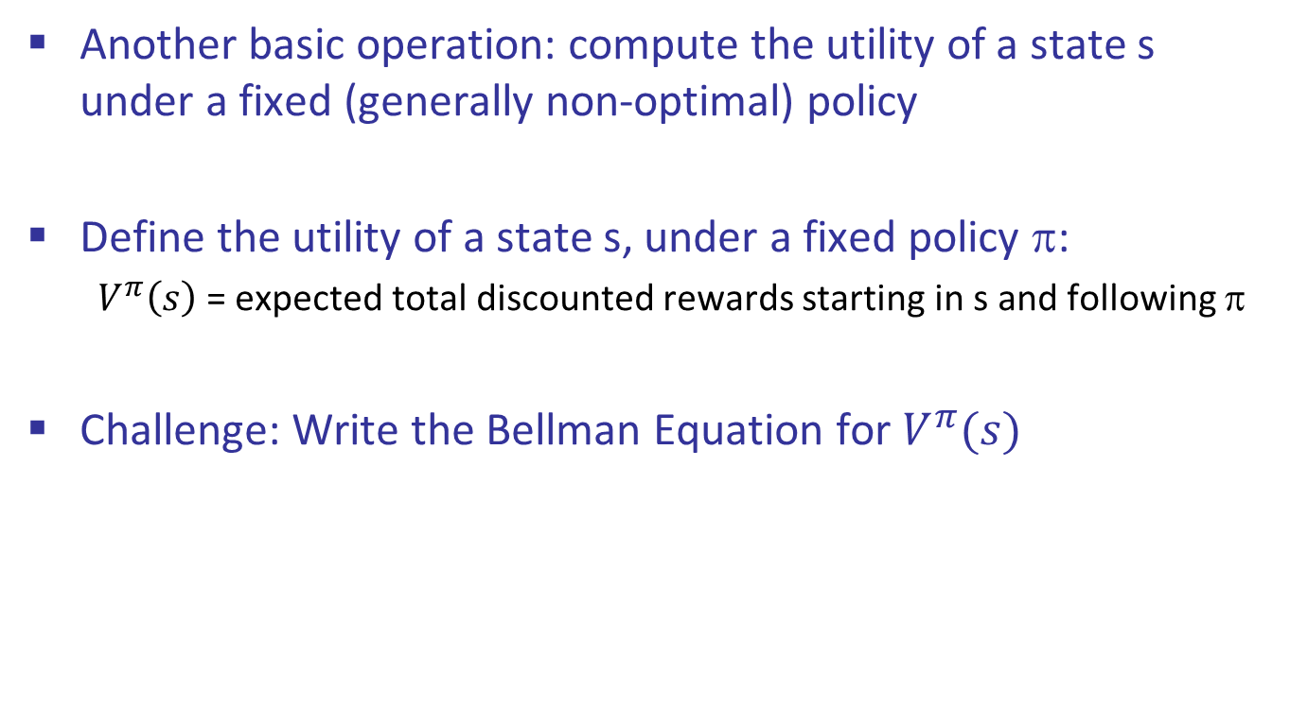
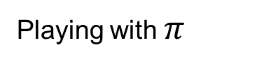
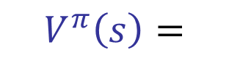

Values of States
Invent the Bellman Equation (Round 2)
Another basic operation: compute the utility of a state s under a fixed (generally non-optimal) policy
Define the utility of a state s, under a fixed policy π:
$V^{π}\left(s\right)$= expected total discounted rewards starting in s and following π
Challenge: Write the Bellman Equation for $V^{π}(s)$
s
π(s)
s, π(s)
s, π(s),s’
s’
$$V^{∗}\left(s\right)=\max_{a}{\sum_{s^{′}}{T\left(s, a, s^{′}\right)\left[R\left(s, a, s^{′}\right)+γV^{∗}\left(s^{′}\right)\right]} }$$
Hint:
Playing optimally
$$V^{π}\left(s\right)=$$
Playing with $π$

Slide 18
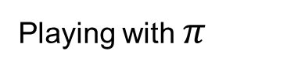

Invent the Bellman Equation (Round 2)
Another basic operation: compute the utility of a state s under a fixed (generally non-optimal) policy
Define the utility of a state s, under a fixed policy π:
$V^{π}\left(s\right)$= expected total discounted rewards starting in s and following π
Challenge: Write the Bellman Equation for $V^{π}(s)$
s
π(s)
s, π(s)
s, π(s),s’
s’
$$V^{∗}\left(s\right)=\max_{a}{\sum_{s^{′}}{T\left(s, a, s^{′}\right)\left[R\left(s, a, s^{′}\right)+γV^{∗}\left(s^{′}\right)\right]} }$$
Hint:
Playing optimally
$$V^{π}\left(s\right)=\sum_{s^{′}}{T\left(s, π\left(s\right), s^{′}\right)\left[R\left(s, π\left(s\right), s^{′}\right)+γV^{π}\left(s^{′}\right)\right]}$$
Playing with $π$

Slide 19
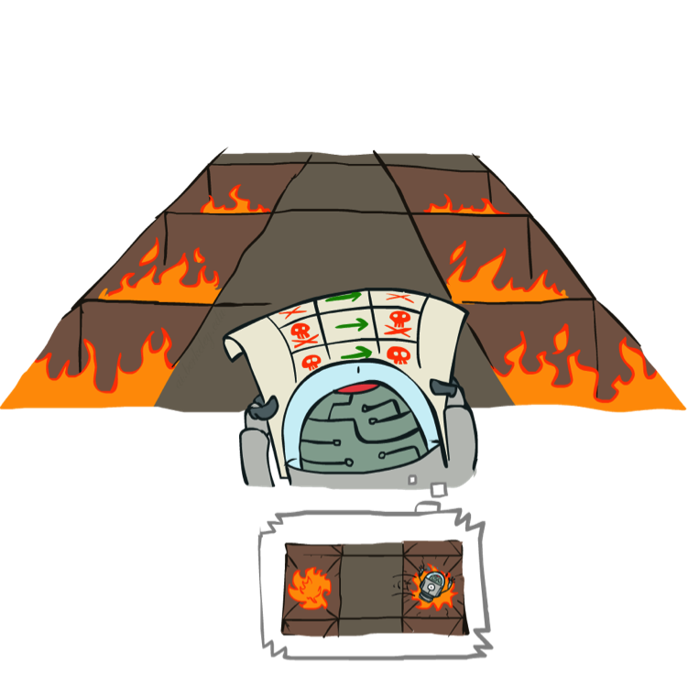
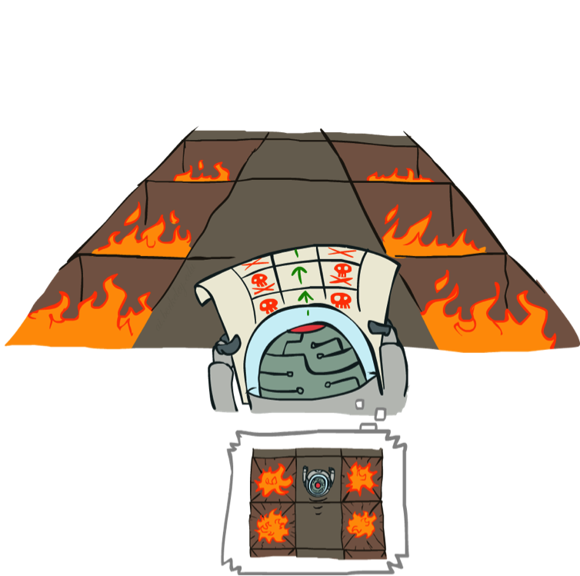
Example: Policy Evaluation
Always Go Right
Always Go Forward

Slide 20
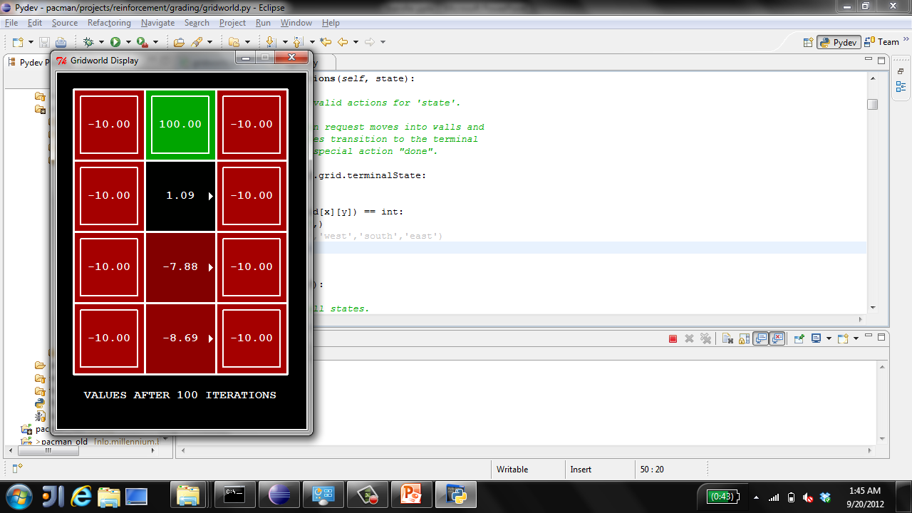
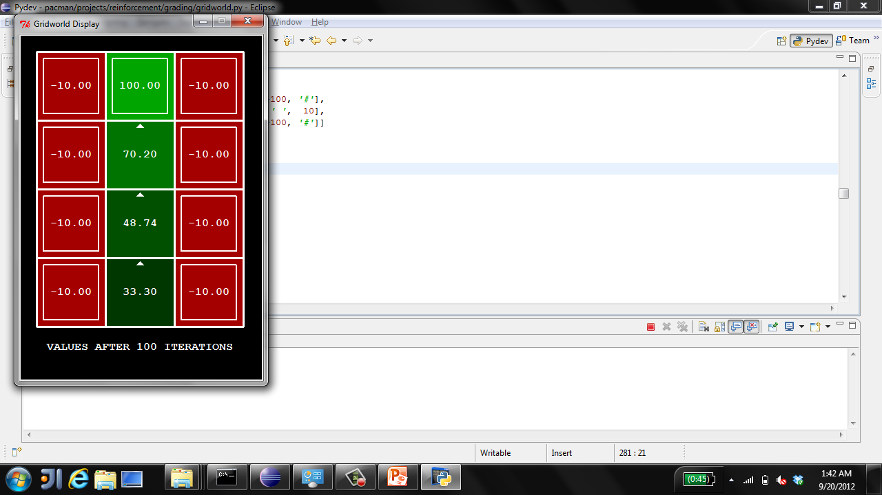
Example: Policy Evaluation
Always Go Right
Always Go Forward

Slide 21
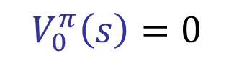

Policy Evaluation
s
How do we calculate the V’s for a fixed policy π?
Idea 1: Turn recursive Bellman equations into updates
(like value iteration)
Efficiency: O(S²) per iteration
Idea 2: Without the maxes, the Bellman equations are just a linear system
Solve with Matlab (or your favorite linear system solver)
π(s)
s, π(s)
$$V_{0}^{π}\left(s\right)=0$$
s, π(s),s’
$$V_{k+1}^{π}\left(s\right)=\sum_{s^{′}}{T\left(s, π\left(s\right), s^{′}\right)\left[R\left(s, π\left(s\right), s^{′}\right)+γV_{k}^{π}\left(s^{′}\right)\right]}$$
s’

Slide 22
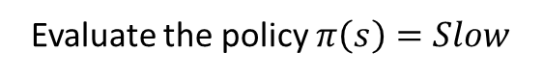
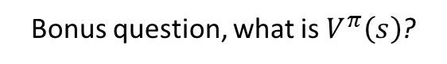

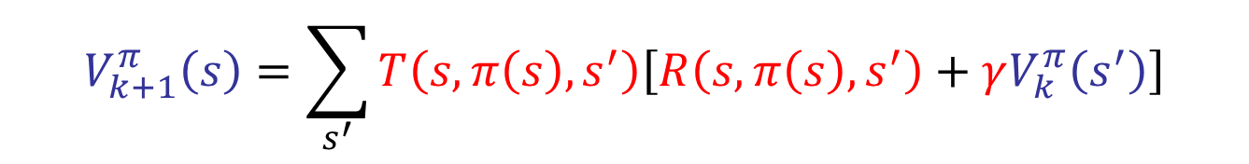
Values of States
Policy Evaluation Exercise
Evaluate the policy $π\left(s\right)=Slow$
$$V_{k+1}^{π}\left(s\right)=\sum_{s^{′}}{T\left(s, π\left(s\right), s^{′}\right)\left[R\left(s, π\left(s\right), s^{′}\right)+γV_{k}^{π}\left(s^{′}\right)\right]}$$
0 0 0
Assume discount $γ=0.2$.
Bonus question, what is $V^{π}\left(s\right)$?

Slide 23
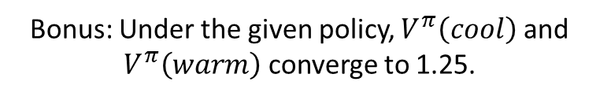
Values of States
Policy Evaluation Exercise
Evaluate the policy $π\left(s\right)=Slow$
1.2 (S) 1.2 (S) 0
$$V_{k+1}^{π}\left(s\right)=\sum_{s^{′}}{T\left(s, π\left(s\right), s^{′}\right)\left[R\left(s, π\left(s\right), s^{′}\right)+γV_{k}^{π}\left(s^{′}\right)\right]}$$
1 (S) 1 (S) 0
0 0 0
Assume discount $γ=0.2$.
Bonus: Under the given policy, $V^{π}\left(cool\right)$ and $V^{π}\left(warm\right)$ converge to 1.25.

Slide 24
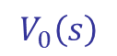
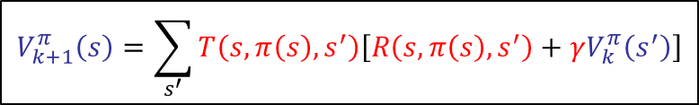
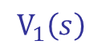
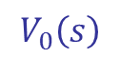
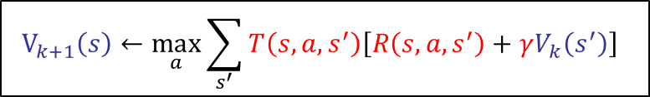
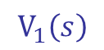
Value Iteration vs. Policy Evaluation
Value iteration lets us compute the expected utility if we play optimally.
0 0 0
$$V_{k+1}\left(s\right)←\max_{a}{\sum_{s^{′}}{T\left(s, a, s^{′}\right)\left[R\left(s, a, s^{′}\right)+γV_{k}\left(s^{′}\right)\right]} }$$
2 1 0
…
$$V_{0}\left(s\right)$$
$$V_{1}\left(s\right)$$
Policy evaluation lets us compute the expected utility if we play using some policy $π(s)$.
0 0 0
$$V_{k+1}^{π}\left(s\right)=\sum_{s^{′}}{T\left(s, π\left(s\right), s^{′}\right)\left[R\left(s, π\left(s\right), s^{′}\right)+γV_{k}^{π}\left(s^{′}\right)\right]}$$
1 1 0
…
$$V_{0}\left(s\right)$$
$$V_{1}\left(s\right)$$

Slide 25
Values of States
Value Iteration vs. Policy Evaluation
Value iteration lets us compute the expected utility if we play optimally.
0 0 0
$$V_{k+1}\left(s\right)←\max_{a}{\sum_{s^{′}}{T\left(s, a, s^{′}\right)\left[R\left(s, a, s^{′}\right)+γV_{k}\left(s^{′}\right)\right]} }$$
2 1 0
…
$$V_{0}\left(s\right)$$
$$V_{1}\left(s\right)$$
Policy evaluation lets us compute the expected utility if we play using some policy $π(s)$.
0 0 0
$$V_{k+1}^{π}\left(s\right)=\sum_{s^{′}}{T\left(s, π\left(s\right), s^{′}\right)\left[R\left(s, π\left(s\right), s^{′}\right)+γV_{k}^{π}\left(s^{′}\right)\right]}$$
1 1 0
…
$$V_{0}\left(s\right)$$
$$V_{1}\left(s\right)$$
Let X(s) be the vector resulting from running policy evaluation on the optimal policy.
Let Y(s) be the vector resulting from running policy evaluation on a policy which always selects the “leftmost” action, i.e. first action on the list of possible actions.
Let Z(s) be the vector resulting from running value iteration.
Assuming we run them all to convergence, how are the values of X, Y, and Z related?

Slide 26
Value Iteration vs. Policy Evaluation
Value iteration lets us compute the expected utility if we play optimally.
0 0 0
$$V_{k+1}\left(s\right)←\max_{a}{\sum_{s^{′}}{T\left(s, a, s^{′}\right)\left[R\left(s, a, s^{′}\right)+γV_{k}\left(s^{′}\right)\right]} }$$
2 1 0
…
$$V_{0}\left(s\right)$$
$$V_{1}\left(s\right)$$
Policy evaluation lets us compute the expected utility if we play using some policy $π(s)$.
0 0 0
$$V_{k+1}^{π}\left(s\right)=\sum_{s^{′}}{T\left(s, π\left(s\right), s^{′}\right)\left[R\left(s, π\left(s\right), s^{′}\right)+γV_{k}^{π}\left(s^{′}\right)\right]}$$
1 1 0
…
$$V_{0}\left(s\right)$$
$$V_{1}\left(s\right)$$
Let X(s) be the vector resulting from running policy evaluation on the optimal policy.
Let Y(s) be the vector resulting from running policy evaluation on a policy which always selects the “leftmost” action, i.e. first action on the list of possible actions.
Let Z(s) be the vector resulting from running value iteration.
Answer: X and Z are equal. All values in Y are less than or equal to X.

Slide 27
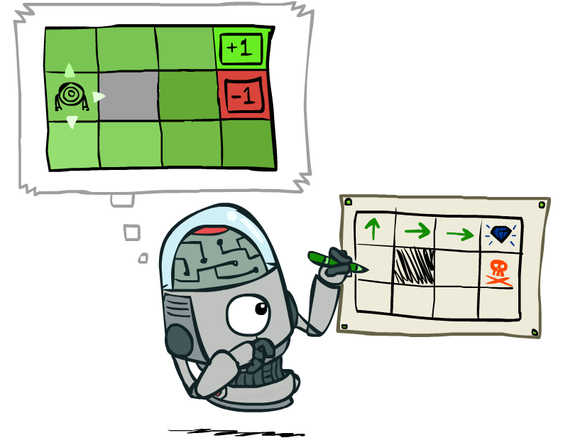
Policy Extraction

Slide 28
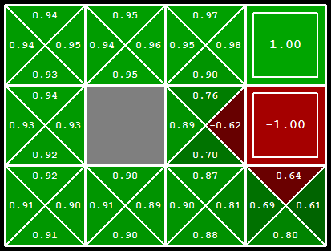
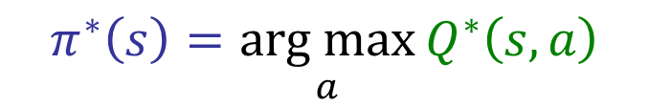
Computing Actions from Q-Values
Let’s imagine we have the optimal q-values:
What is the optimal policy?
Completely trivial to decide!
Important lesson: actions are easier to select from q-values than values!
$$π^{∗}\left(s\right)=\underset{a}{arg max}{Q^{∗}\left(s, a\right)}$$

Slide 29
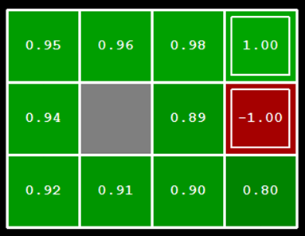
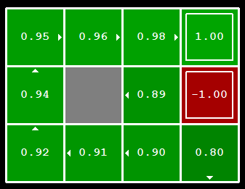
Computing Actions from Values
Let’s imagine we have the optimal values V*(s)
What is the optimal policy, i.e. how should we act?
It’s not obvious!
???

Slide 30
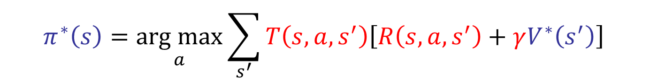
Computing Actions from Values
Let’s imagine we have the optimal values V*(s)
What is the optimal policy?
It’s not obvious!
We need to do a mini-expectimax (one step)
In other words, compute q-values, pick action that goes with maximum for each state.
This is called policy extraction, since it gets the policy implied by the values
Important observation: actions are easier to select from q-values than values!
$$π^{∗}\left(s\right)=\underset{a}{arg max}{\sum_{s^{′}}{T\left(s, a, s^{′}\right)\left[R\left(s, a, s^{′}\right)+γV^{∗}\left(s^{′}\right)\right]} }$$

Slide 31
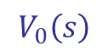
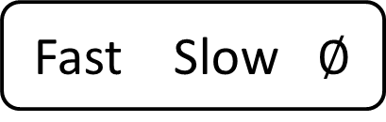
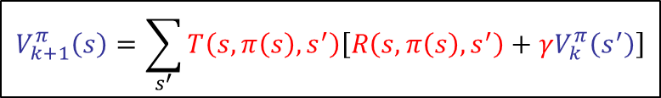
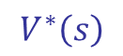



Value Iteration, Policy Evaluation, Policy Extraction
Value iteration lets us compute the expected utility if we play optimally.
0 0 0
$$V_{k+1}\left(s\right)←\max_{a}{\sum_{s^{′}}{T\left(s, a, s^{′}\right)\left[R\left(s, a, s^{′}\right)+γV_{k}\left(s^{′}\right)\right]} }$$
2 1 0
…
$$V_{0}\left(s\right)$$
$$V_{1}\left(s\right)$$
Policy evaluation lets us compute the expected utility if we play using some policy $π(s)$.
0 0 0
$$V_{k+1}^{π}\left(s\right)=\sum_{s^{′}}{T\left(s, π\left(s\right), s^{′}\right)\left[R\left(s, π\left(s\right), s^{′}\right)+γV_{k}^{π}\left(s^{′}\right)\right]}$$
1 1 0
…
$$V_{0}\left(s\right)$$
$$V_{1}\left(s\right)$$
Policy extraction lets us compute the optimal policy from an optimal vector $V^{∗}\left(s\right)$.
2.375 1.375 0
$$π^{∗}\left(s\right)=\underset{a}{arg max}{\sum_{s^{′}}{T\left(s, a, s^{′}\right)\left[R\left(s, a, s^{′}\right)+γV^{∗}\left(s^{′}\right)\right]} }$$
Fast Slow $∅$
$$V^{∗}\left(s\right)$$
$$π^{∗}\left(s\right)$$

Slide 32

Policy Iteration

Slide 33
Problems with Value Iteration
Value iteration repeats the Bellman updates:
Problem 1: It’s slow – O(S²A) per iteration
Problem 2: The best action at each state rarely changes
Problem 3: The policy often converges long before the values
0 0 0
$$V_{k+1}\left(s\right)←\max_{a}{\sum_{s^{′}}{T\left(s, a, s^{′}\right)\left[R\left(s, a, s^{′}\right)+γV_{k}\left(s^{′}\right)\right]} }$$
3.5 2.6 0
…
$$V_{0}\left(s\right)$$
$$V_{1}\left(s\right)$$
s
a
s, a
s,a,s’
s’
[Demo: value iteration (L9D2)]
Notes:
Demo steps through value iteration; snapshots of values shown on next slides.

Slide 34

k=0
Noise = 0.2
Discount = 0.9
Living reward = 0
Notes:
Assuming zero living reward

Slide 35

k=1
Noise = 0.2
Discount = 0.9
Living reward = 0
Notes:
Assuming zero living reward

Slide 36

k=2
Noise = 0.2
Discount = 0.9
Living reward = 0
Notes:
Assuming zero living reward

Slide 37

k=3
Noise = 0.2
Discount = 0.9
Living reward = 0
Notes:
Assuming zero living reward

Slide 38

k=4
Noise = 0.2
Discount = 0.9
Living reward = 0
Notes:
Assuming zero living reward

Slide 39

k=5
Noise = 0.2
Discount = 0.9
Living reward = 0
Notes:
Assuming zero living reward

Slide 40

k=6
Noise = 0.2
Discount = 0.9
Living reward = 0
Notes:
Assuming zero living reward

Slide 41

k=7
Noise = 0.2
Discount = 0.9
Living reward = 0
Notes:
Assuming zero living reward

Slide 42

k=8
Noise = 0.2
Discount = 0.9
Living reward = 0
Notes:
Assuming zero living reward

Slide 43

k=9
Noise = 0.2
Discount = 0.9
Living reward = 0
Notes:
Assuming zero living reward

Slide 44

k=10
Noise = 0.2
Discount = 0.9
Living reward = 0
Notes:
Assuming zero living reward

Slide 45

k=11
Noise = 0.2
Discount = 0.9
Living reward = 0
Notes:
Assuming zero living reward

Slide 46

k=12
Noise = 0.2
Discount = 0.9
Living reward = 0
Notes:
Assuming zero living reward

Slide 47

k=100
Noise = 0.2
Discount = 0.9
Living reward = 0
Notes:
Assuming zero living reward

Slide 48
Policy Iteration
Alternative approach for optimal values:
Step 1: Policy evaluation: calculate utilities for some fixed policy (not optimal utilities!) until convergence
Step 2: Policy improvement: update policy using one-step look-ahead with resulting converged (but not optimal!) utilities as future values
Repeat steps until policy converges
This is policy iteration
It’s still optimal!
Can converge (much) faster under some conditions

Slide 49



Policy Iteration
Evaluation: For fixed current policy $π_{i}$, find values with policy evaluation:
Iterate until values converge:
Improvement: For fixed values, get a better policy using policy extraction
Do a one-step look ahead using expectimax.
In other words, compute q-values, pick action that goes with maximum for each state.
$$V_{k+1}^{π_{i}}\left(s\right)=\sum_{s^{′}}{T\left(s, π_{i}\left(s\right), s^{′}\right)\left[R\left(s, π_{i}\left(s\right), s^{′}\right)+γV_{k}^{π_{i}}\left(s^{′}\right)\right]}$$
$$π_{i+1}\left(s\right)=\underset{a}{arg max}{\sum_{s^{′}}{T\left(s, a, s^{′}\right)\left[R\left(s, a, s^{′}\right)+γV^{π_{i}}\left(s^{′}\right)\right]} }$$

Slide 50












Policy Evaluation, Extraction, and Iteration
Policy evaluation lets us compute the expected utility if we play using some policy $π(s)$.
0 0 0
$$V_{k+1}^{π}\left(s\right)=\sum_{s^{′}}{T\left(s, π\left(s\right), s^{′}\right)\left[R\left(s, π\left(s\right), s^{′}\right)+γV_{k}^{π}\left(s^{′}\right)\right]}$$
1 1 0
…
$$V_{0}\left(s\right)$$
$$V_{1}\left(s\right)$$
Policy extraction lets us compute the optimal policy from an optimal vector $V^{∗}\left(s\right)$.
2.375 1.375 0
$$π^{∗}\left(s\right)=\underset{a}{arg max}{\sum_{s^{′}}{T\left(s, a, s^{′}\right)\left[R\left(s, a, s^{′}\right)+γV^{∗}\left(s^{′}\right)\right]} }$$
Fast Slow $∅$
$$V^{∗}\left(s\right)$$
$$π^{∗}\left(s\right)$$
Policy iteration is a call to evaluate, followed by a call to extract.
Given a policy $π_{i}$, policy iteration outputs a better policy $π_{i+1}$.
Slow Slow $∅$
$V^{π_{0}}$ = evaluate($π_{0}$)
$π_{1}$ = extract($V^{π_{0}}$)
Fast Slow $∅$
$$π_{0}$$
iterate
$$π_{1}$$

Slide 51









More Thorough Example
Come up with an arbitrary initial policy $π_{0}$, say $π_{0}(s)$ = [slow, slow, $∅$].
Compute the expected utilities for this policy if we use policy $π_{0}$ using policy evaluation.
After converging (possibly many many iterations), this yields a vector $V^{π_{i}}(s)$.
$$π_{0}(s)=[slow, slow, ∅]$$
0 0 0
$$V_{1}^{π_{0}}\left(s\right)=\sum_{s^{′}}{T\left(s, π_{0}\left(s\right), s^{′}\right)\left[R\left(s, π_{0}\left(s\right), s^{′}\right)+γV_{0}^{π_{0}}\left(s^{′}\right)\right]}$$
1 1 0
$$V_{0}^{π_{0}}\left(s\right)$$
$$V_{1}^{π_{0}}\left(s\right)$$
1 1 0
$$V_{2}^{π_{0}}\left(s\right)=\sum_{s^{′}}{T\left(s, π_{0}\left(s\right), s^{′}\right)\left[R\left(s, π_{0}\left(s\right), s^{′}\right)+γV_{1}^{π_{0}}\left(s^{′}\right)\right]}$$
1.2 1.2 0
$$V_{1}^{π_{0}}\left(s\right)$$
$$V_{2}^{π_{0}}\left(s\right)$$
…
1.25 1.25 0
$$V_{182}^{π_{0}}\left(s\right)$$

Slide 52






More Thorough Example
Come up with an arbitrary initial policy $π_{0}$, say $π_{0}(s)$ = [slow, slow, $∅$].
Compute the expected utilities for this policy if we use policy $π_{0}$ using policy evaluation.
After converging (possibly many many iterations), this yields a vector $V^{π_{i}}(s)$.
The expected utility of the policy [slow, slow, $∅$] is [1.25, 1.25, 0]
Compute a better policy $π_{1}$ using policy iteration.
In other words, compute q-values for each possible choice, pick new best.
Can repeat this process to get even better policies $π_{2}$, $π_{3}$, etc.
1.25 1.25 0
$$V_{182}^{π_{0}}\left(s\right)$$
1.25 1.25 0
$$π_{1}\left(s\right)=\underset{a}{arg max}{\sum_{s^{′}}{T\left(s, a, s^{′}\right)\left[R\left(s, a, s^{′}\right)+γV^{π_{0}}\left(s^{′}\right)\right]} }$$
Fast Slow $∅$
$$V^{π_{0}}\left(s\right)$$
$$π_{1}\left(s\right)$$

Slide 53
Value Iteration vs. Policy Iteration
Both value iteration and policy iteration compute the same thing (all optimal values)
In value iteration (previous lecture):
Every iteration updates both the values and (implicitly) the policy
We don’t track the policy, but taking the max over actions implicitly recomputes it
In policy iteration (this lecture):
We do several passes that update utilities with fixed policy (each pass is fast because we consider only one action, not all of them)
After the policy is evaluated, a new policy is chosen (slow like a value iteration pass)
The new policy will be better (or we’re done)
Both are dynamic programs for solving MDPs

Slide 54
Summary: MDP Algorithms
So you want to….
Compute optimal values: use value iteration or policy iteration
Compute values for a particular policy: use policy evaluation
Turn your values into a policy: use policy extraction (one-step lookahead)
These all look the same!
They basically are – they are all variations of Bellman updates
They all use one-step lookahead expectimax fragments
They differ only in whether we plug in a fixed policy or max over actions

Slide 55



Double Bandits

Slide 56
Double-Bandit MDP
Actions: Blue, Red
States: Win, Lose
No discount
100 time steps
Both states have the same value
0.25 $0
0.75
$2
W
L
0.25
$0
$1
1.0
$1
1.0
0.75 $2

Slide 57
Offline Planning
Solving MDPs is offline planning
You determine all quantities through computation
You need to know the details of the MDP
You do not actually play the game!
No discount
100 time steps
Both states have the same value
0.25 $0
Value
0.75
$2
W
0.25
$0
Play Red
150
L
$1
1.0
$1
1.0
0.75 $2
Play Blue
100

Slide 58
Let’s Play!
$2
$2
$0
$2
$2
$2
$2
$0
$0
$0

Slide 59
Online Planning
Rules changed! Red’s win chance is different.
?? $0
??
$2
W
L
??
$0
$1
1.0
$1
1.0
?? $2

Slide 60
Let’s Play!
$0
$0
$0
$2
$0
$2
$0
$0
$0
$0

Slide 61
What Just Happened?
That wasn’t planning, it was learning!
Specifically, reinforcement learning
There was an MDP, but you couldn’t solve it with just computation
You needed to actually act to figure it out
Important ideas in reinforcement learning that came up
Exploration: you have to try unknown actions to get information
Exploitation: eventually, you have to use what you know
Regret: even if you learn intelligently, you make mistakes
Sampling: because of chance, you have to try things repeatedly
Difficulty: learning can be much harder than solving a known MDP

Slide 62
Next Time: Reinforcement Learning!

Slide 63

Asynchronous Value Iteration*
In value iteration, we update every state in each iteration
Actually, any sequences of Bellman updates will converge if every state is visited infinitely often
In fact, we can update the policy as seldom or often as we like, and we will still converge
Idea: Update states whose value we expect to change:
If is large then update predecessors of s

Slide 64

Interlude

